Slide 1
Machine Learning Model for predicting if a school is a Top Tier Business School
Nanda Rajarathinam
August 2016

Slide 2
Introduction
There are several Business schools around the world and only a small percentage of them are consistently ranked as top tier institutions
The objective of this analysis is to build a machine learning model to predict whether a given university’s Business school is a top tier school or not.
This was accomplished through the following steps:
Scrape the Business school ranking data from The Economist website for the year 2015
Clean up the data, perform Exploratory data analysis and hypothesis tests
Build a supervised Machine Learning model to predict if a school is a top tier school using the above data

Slide 3
About the data…
The data was scraped from The Economist website
500 observations (2011 through 2015) and 23 variables
Variables
[1] "School.Name" [2] "Rank" [3] "Location" [4] "Programme.fees" [5] "Student.rating.of.faculty.out.of.5"
[6] "Ratio.of.faculty.to.students" [7] "Student.rating.of.programme.out.of.5" [8] "Average.GMAT.score"
[9] "Average.work.experience" 10] "Average.age" [11] "Student.rating.of.cohort" 12] "Percentage.who.received.a.job.offer"
[13] "Post.MBA.salary" [14] "Percent.Increase.on.pre.MBA.salary" [15] "Principal.recruiters"
[16] "Student.rating.of.careers.service" [17] "Percent.graduates.finding.jobs.through.careers.services"
[18] "Geographical.diversity.score" [19] "Student.rating.of.faculty"
[20] "Student.rating.of.programme" [21] "Average.GMAT" [22] "Region" [23] "Tier"

Slide 4
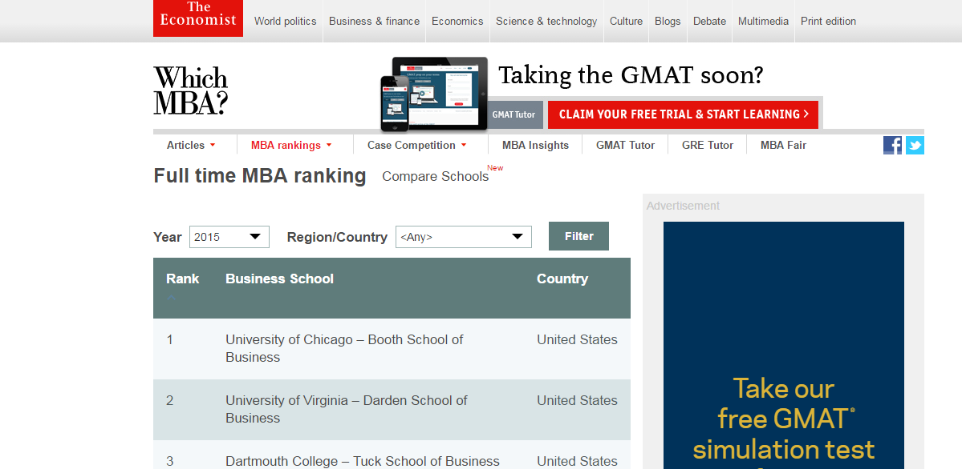
The Economist – 2015 Full time MBA Ranking

Slide 5
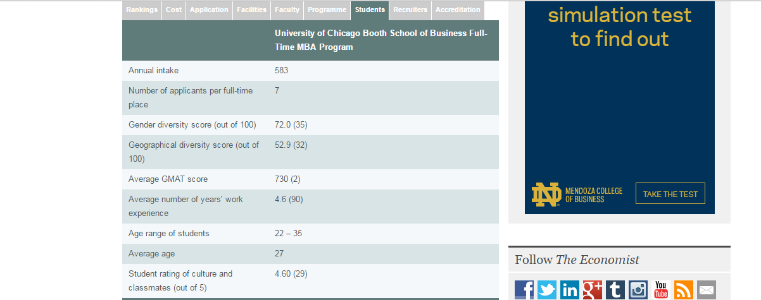
Business School Details

Slide 6
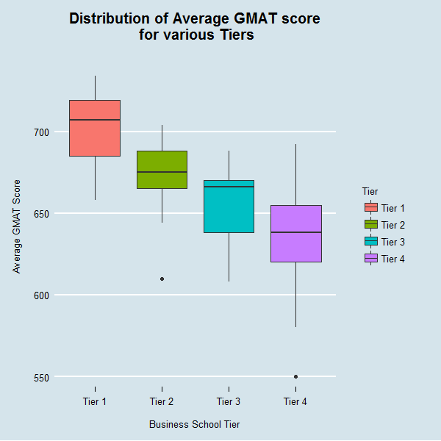
Distribution of Average GMAT scores by Tiers

Slide 7
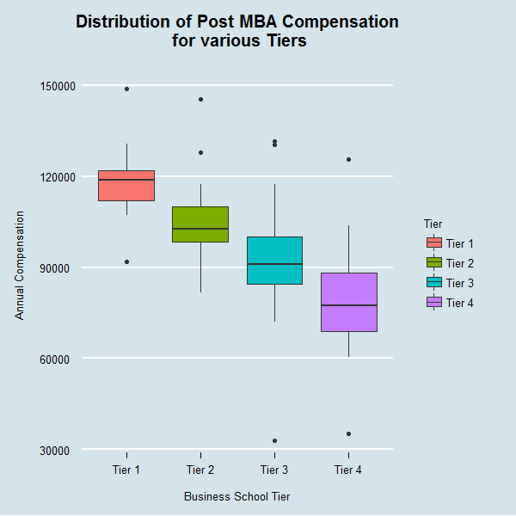
Distribution of Post MBA Compensation by Tiers

Slide 8
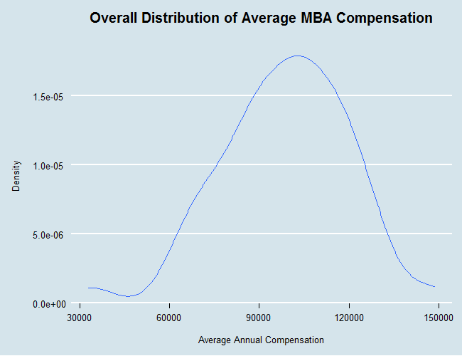
Distribution of Average Annual Compensation

Slide 9
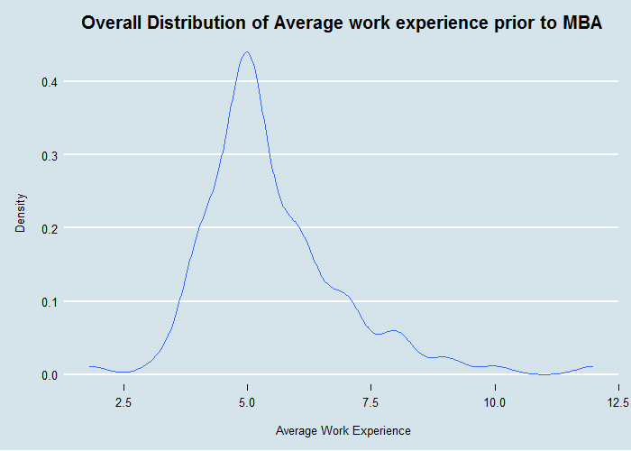
Distribution of Average Work Experience prior to MBA

Slide 10
Hypothesis Tests performed…
Test Objective | Test Performed | P Value | Inference
To Test if the average GMAT score is same for all four Business school tiers | ANOVA | 3.87e-14 *** | The average GMAT score for at least one of the tiers differs from the average GMAT score of the others
To Test if the average Diversity score of the MBA cohort is same for U.S. and Rest of the World | Two Sample T test | 0.0002662 *** | The true difference in means between US business schools' diversity score and international business schools' diversity score is not 0
To Test if the average Student rating of the MBA program is same for all four Regions | ANOVA | 0.124 | There is no difference in the average Student rating of the MBA program across North America, Europe, APAC & Australia
To Test if the average Student rating of the Faculty is same for all four Regions | ANOVA | 0.00119 ** | The average Student rating of the Faculty for at least one of the regions differs from the average Student rating of the Faculty of the other 3 regions

Slide 11
Logistic Regression Model
Top Tier Business School ~ Average GMAT score + Post MBA salary + Percentage who received job offer + Percent graduates finding jobs through school’s career services + Student rating of program + Student rating of careers service + Ratio of Faculty to students
Statistically Significant Predictor Variables
Average GMAT score
Post MBA salary
Percentage who received job offer
Percent graduates finding jobs through school’s career services
Intercept

Slide 12
Logistic Regression Outcome – Odds of Success
Variable | Slope Coefficient
Average GMAT score | For every additional one point increase on the average GMAT score, the odds of that school being a top tier Business school is multiplied by approximately 1.113, holding all other variables constant.
Post MBA salary | For every additional $1 increase in the average salary of the students, the odds of that school being a top tier Business school is multiplied by approximately 1, holding all other variables constant
Percentage who received job offer | For every additional percentage point increase in the students who get a job offer, the odds of that school being a top tier Business school is multiplied by approximately 0.731, holding all other variables constant
Percent graduates finding jobs through school’s career services | For every additional percentage point increase in the students who get a job offer through the School's career services team, the odds of that school being a top tier Business school is multiplied by approximately 1.134, holding all other variables constant
Intercept | The odds of a Business school being a Top Tier school is approximately 0 when the average GMAT score of the students joining the program is zero, when none of the students received a job offer and post MBA compensation is zero

Slide 13
Test Accuracy
Test Dataset | 0 | 1
0 (Not a Top Tier School) | 22 | 2
1 (Top Tier School) | 1 | 7
Train Dataset | 0 | 1
0 (Not a Top Tier School) | 51 | 0
1 (Top Tier School) | 7 | 10
McFadden’s R squared = 66.2%

Slide 14
Next Steps
Use step wise selection to add / remove predictors and see if that improve model’s R squared
Expand the test dataset and rerun the model for other years (2012 through 2014) and verify prediction accuracy
Try comparing this Economist ranking / tiering against Forbes Business school ranking

Slide 15
Insights
GMAT Score, Annual Compensation(upon graduation), percentage of students who received a job offer and effectiveness of the school’s Career Services group are the four predictors that are statistically significant (at 5 % significance level) in determining whether a school is a Top tier Business school
Average GMAT score of the cohort is lower in Europe compared to the U.S
Asia Pacific and Australian Business schools tend to have lower geographical diversity compared to their counterparts in Europe and U.S.
There is no statistical significance regarding the Students rating (perception) of the full time MBA program across the various regions of the world. But there is a statistical significance regarding students rating of the Faculty across the Business schools.
Outside of the U.S., Students tend to have a higher work experience before pursuing a full time MBA compared to U.S based Business schools
Based on the Principal recruiters information, Consulting seems to be the industry of choice for the Full time MBA graduates followed by Technology and Financial Services.

